Slide 1
Epic Games Team 2 VR Experiments
Active vs Passive Control
David, Divya, Pallavi, Ricky, Vikas

Slide 2
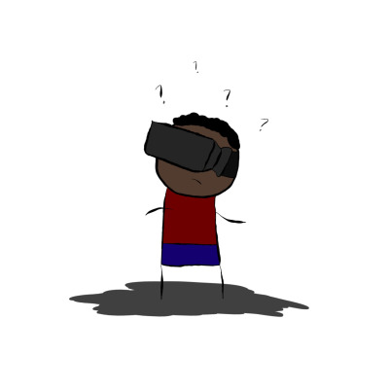
What is Virtual Reality?
Replication of an environment that simulates physical presence in real or imagined worlds.
Tighter control over sensory inputs than other applications
Heightened user immersion in the experience.

Slide 3

Research Objective
How to Provide Best VR Experience
User Controlled Motion vs Passive Motion
Study Effect of Motion Control on Engagement

Slide 4

Active vs Passive Control?
Active User Control
* Control of in-game character
* Command of different levels
Passive Control
* Limited Control
* Movie like experience

Slide 5
Hypothesis
We believe, all else being equal, more user control over motion leads to more engaging VR experience.

Slide 6
Background
Research Suggests That User Controlled Motion Lessens Cybersickness in VR
Kay M. Stanney , Phillip Hash
Locus of User-Initiated Control in Virtual Environments: Influences on Cybersickness, Presence: Teleoperators and Virtual Environments
October 1998

Slide 7
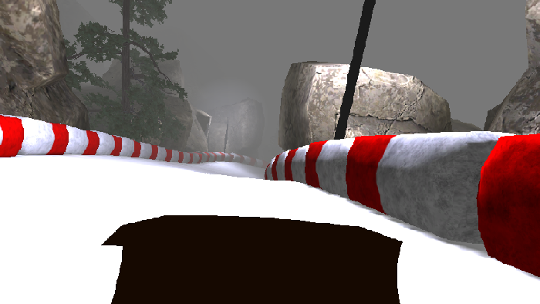
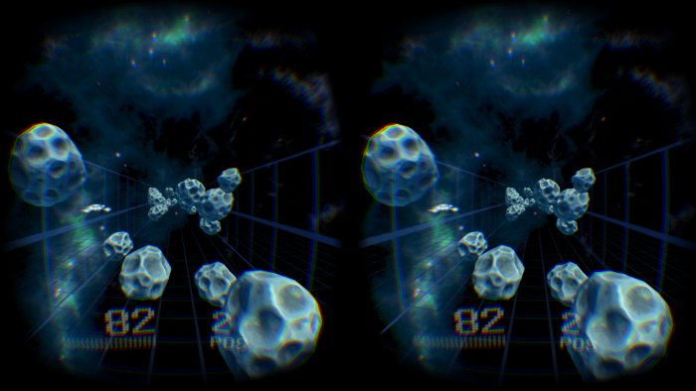
Games
Asteroid Race - head movement only vs. head movement and speed control
Luge - completely passive vs. control over left/right

Slide 8
Introduction to Experiment
Divided the experiment into two games so that the results are not biased towards quality of one game
Each game has an active and a passive version
Aim is to obtain accurate results across multiple levels of engagement
Participants fill surveys after each trial

Slide 9
Experimental Design
10 participants of 22-26 age group with varying past exposure to VR
Game and control orders are randomized between users to avoid biasing
User can end task if they become nauseous or ill
Glitches in game are considered part of the experience
Screen tearing
Screen flicker
Luge decides you are stuck on the wall

Slide 10
Survey Details
Participants Complete Game Engagement Questionnaire (GEQ) After Each Trial
 | Active | Passive
Luge
Asteroid Racer

Slide 11
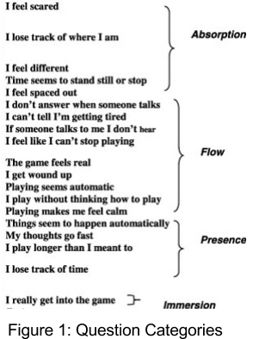
Game Engagement Questionnaire
Participants answered the questions as Yes/ No/ Sort of
We have the graphs explaining the results in each category.
Active and passive parameter in both the games are compared in the graphs

Slide 12
Example Procedure
How many times have you used VR before?
Luge
User Control
GEQ
Luge
Passive
GEQ
VR is awesome right?
Asteroid Racer
User Control
GEQ
Asteroid Racer
User Control
GEQ

Slide 13
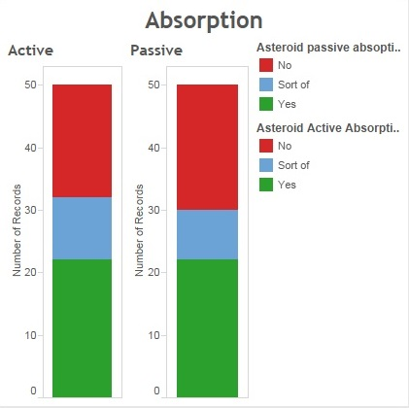
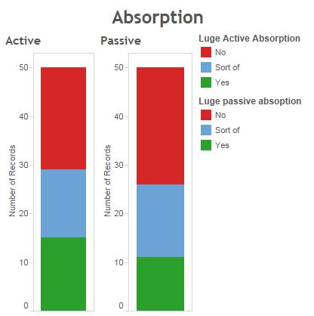
Asteroid Racer
Luge

Slide 14
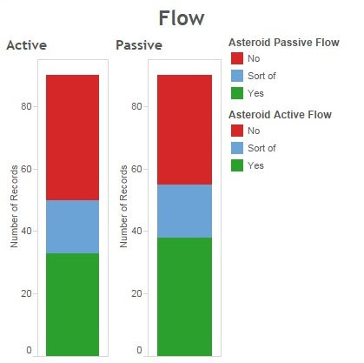
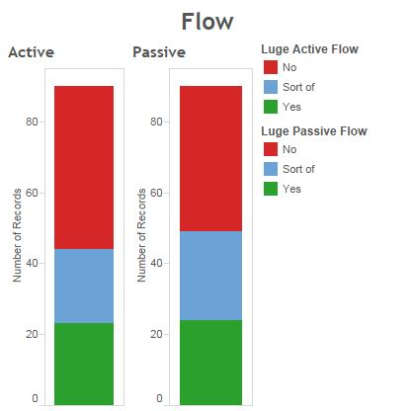
Asteroid Racer
Luge

Slide 15
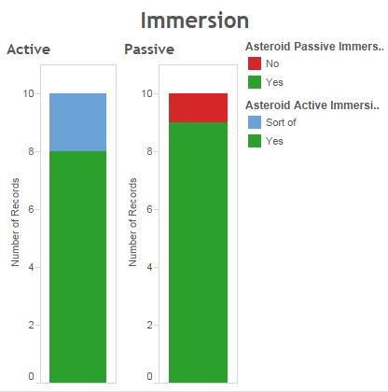
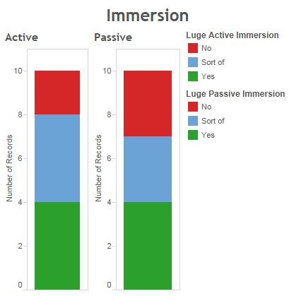
Asteroid Racer
Luge

Slide 16
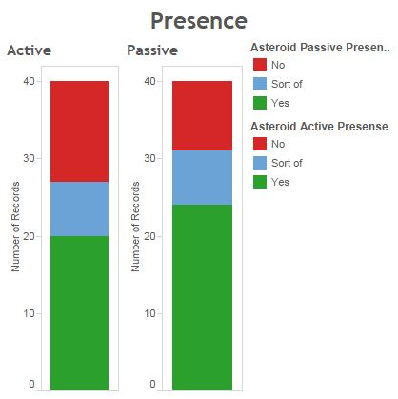
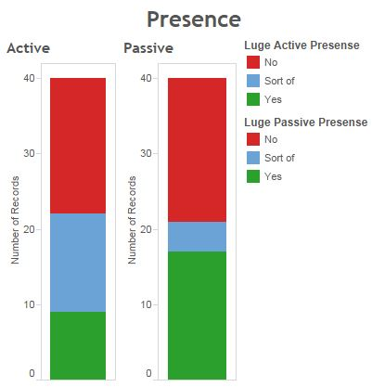
Asteroid Racer
Luge

Slide 17
Discussion of Results
Hypothesis Not Confirmed
Blame the Noobs
Participants new to VR
Participants new to games
Being escorted through the game (as a noob) is plausibly more engaging than having total control

Slide 18
Further Research Suggestions
Participants More Familiar with VR
Participants More Familiar with Game
More elaborate surveys in a highly professional environment
Higher Quality Games
Better distinction between passive & active control

Slide 19
Participants Say...
“Is it over already? I wanna play more!”
“I’m gonna let you finish, but Epic Team 2 is the best Epic team of all time!” - Kanye West *
“I am not wearing that thing again…”
*this quote may have been fabricated.

